Slide 1
Microsoft SQL Server 2019
Design & Develop
Masoud Mirzakhani
Senior DW/ ETL/ BI Architect

Slide 2
Types of SQL Command
DDL(Data Definition Language)
CREATE
DROP
ALTER
RENAME
TRUNCATE

Slide 3
Types of SQL Command
DML(Data Manipulation Language)
INSERT
UPDATE
DELETE
MERGE
LOCK

Slide 4
Types of SQL Command
DQL(Data Query Language)
SELECT

Slide 5
Types of SQL Command
DCL(Data Control Language)
GRANT
REVOKE

Slide 6
Types of SQL Command
TCL(Transaction Control Language)
BEGIN TRAN
COMMIT
ROLLBACK
SAVEPOINT

Slide 7
Types of Programming
Procedural (Imperative)
HOW
Declarative
WHAT

Slide 8
Logical Query Processing
(5) SELECT (5-2) DISTINCT (7) TOP(<top_specification>)
(5-1) <select_list>
(1) FROM
(1-J) <left_table> <join_type> JOIN <right_table> ON <on_predicate>
(1-A) <left_table> <apply_type> APPLY <right_input_table> AS <alias>
(1-P) <left_table> PIVOT(<pivot_specification>) AS <alias>
(1-U) <left_table> UNPIVOT(<unpivot_specification>) AS <alias>
(2) WHERE
<where_predicate>
(3) GROUP BY
<group_by_specification>
(4) HAVING
<having_predicate>
(6) ORDER BY
<order_by_list>
(7) OFFSET
<offset_specification> ROWS FETCH NEXT <fetch_specification> ROWS ONLY;

Slide 9
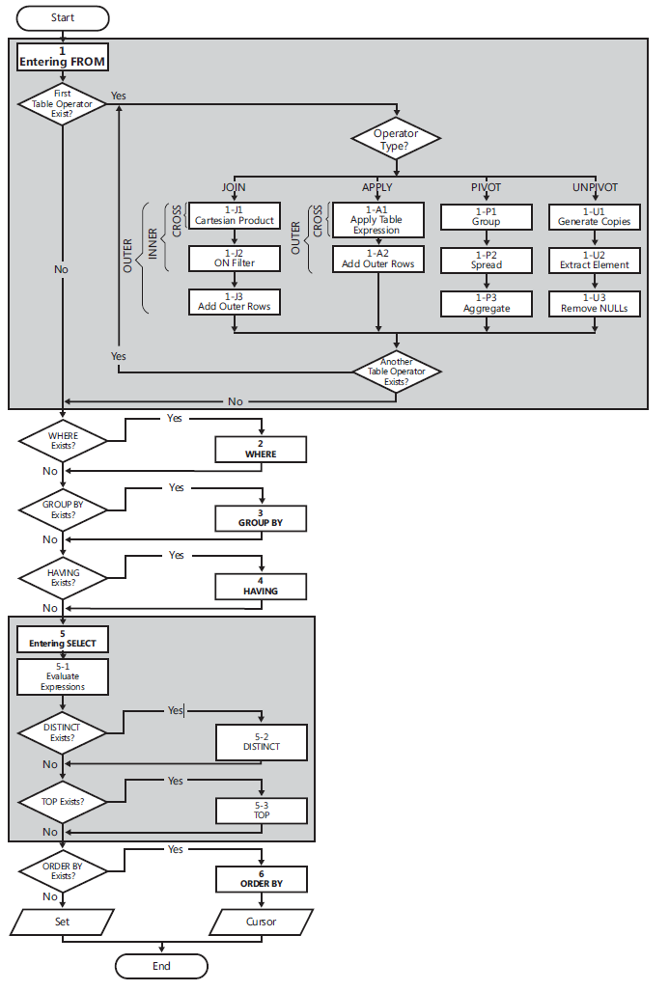
Logical Query Processing

Slide 10
(1) FROM
Identify query’s source tables (sets)
Process table (set) operators
JOIN
APLLY
PIVOT
UNPIVOT

Slide 11
(5-1) <select_list>
Evaluate Expressions
Column
Fixed value
SQL functions
Combination of one or more
Columns,
Fixed values
SQL functions

Slide 12
(5-1) <select_list>
* (Asterisk)
Aliasing
expression AS <alias>
expression <alias>
<alias> = expression

Slide 13
(2) WHERE
Filter the rows from previous step
Based on <where_predicate>
Only rows which evaluated to TRUE go to next step

Slide 14
(1-J) JOIN
Employee
CityID | Name | ID
3 | Ali | 1
4 | Omid | 2
5 | Reza | 3
City
Name | ID
Tehran | 3
Shiraz | 4
Tabriz | 5
{ (1, Ali, 3),
(2, Omid, 4),
(3, Reza, 5)
}
{ (3, Tehran),
(4, Shiraz),
(5, Tabriz)
}
Result
CityName | CityID | Name | ID
Tehran | 3 | Ali | 1
Shiraz | 4 | Omid | 2
Tabriz | 5 | Reza | 3
{ (1, Ali, 3, Tehran),
(2, Omid, 4, Shiraz),
(3, Reza, 5, Tabriz)
}

Slide 15
(1-J1) Cartesian Product
E = { (1, Ali, 3), (2, Omid, 4), (3, Reza, 5)}
C = { (3, Tehran), (4, Shiraz),(5, Tabriz)}
E * C = ?
(3, Tehran)
((1, Ali, 3), (3, Tehran))
(1, Ali, 3)
(4, Shiraz)
((1, Ali, 3), (4, Shiraz))
(5, Tabriz)
((1, Ali, 3), (5, Tabriz))
(3, Tehran)
((2, Omid, 4), (3, Tehran))
(2, Omid, 4)
(4, Shiraz)
((2, Omid, 4), (4, Shiraz))
(5, Tabriz)
((2, Omid, 4), (5, Tabriz))
(3, Tehran)
((3, Reza, 5), (3, Tehran))
(3, Reza, 5)
(4, Shiraz)
((3, Reza, 5), (4, Shiraz))
(5, Tabriz)
((3, Reza, 5), (5, Tabriz))

Slide 16
(1-J2) On Predicate
ON | City |  | Employee
Evaluation | Name | ID | CityID | Name | ID
True | Tehran | 3 | 3 | Ali | 1
False | Shiraz | 4 | 3 | Ali | 1
False | Tabriz | 5 | 3 | Ali | 1
False | Tehran | 3 | 4 | Omid | 2
True | Shiraz | 4 | 4 | Omid | 2
False | Tabriz | 5 | 4 | Omid | 2
False | Tehran | 3 | 5 | Reza | 3
False | Shiraz | 4 | 5 | Reza | 3
True | Tabriz | 5 | 5 | Reza | 3
City |  | Employee
Name | ID | CityID | Name | ID
Tehran | 3 | 3 | Ali | 1
Shiraz | 4 | 4 | Omid | 2
Tabriz | 5 | 5 | Reza | 3

Slide 17
(1-J3) Add Outer Rows
Employee
CityID | Name | ID
3 | Ali | 1
4 | Omid | 2
City
Name | ID
Shiraz | 4
Tabriz | 5
{ (1, Ali, 3),
(2, Omid, 4)
}
{ (4, Shiraz),
(5, Tabriz)
}
Result
CityName | CityID | Name | ID
NULL | 3 | Ali | 1
Shiraz | 4 | Omid | 2
{ (1, Ali, 3, NULL),
(2, Omid, 4, Shiraz)
}

Slide 18
(1-J3) Add Outer Rows
E = { (1, Ali, 3), (2, Omid, 4)}
C = { (4, Shiraz), (5, Tabriz)}
E * C = ?
(1, Ali, 3)
(4, Shiraz)
((1, Ali, 3), (4, Shiraz))
(5, Tabriz)
((1, Ali, 3), (5, Tabriz))
(2, Omid, 4)
(4, Shiraz)
((2, Omid, 4), (4, Shiraz))
(5, Tabriz)
((2, Omid, 4), (5, Tabriz))

Slide 19
(1-J3) Add Outer Rows
ON | City |  | Employee
Evaluation | Name | ID | CityID | Name | ID
False | Shiraz | 4 | 3 | Ali | 1
False | Tabriz | 5 | 3 | Ali | 1
True | Shiraz | 4 | 4 | Omid | 2
False | Tabriz | 5 | 4 | Omid | 2
City |  | Employee
Name | ID | CityID | Name | ID
Shiraz | 4 | 4 | Omid | 2
NULL | NULL | 3 | Ali | 1
Tabriz | 5 | NULL | NULL | NULL
OUTER ROW | Employee
Evaluation | CityID | Name | ID
True | 3 | Ali | 1
False | 4 | Omid | 2
OUTER ROW | City
Evaluation | Name | ID
False | Shiraz | 4
True | Tabriz | 5

Slide 20
JOINs
Add Outer Rows | On Predicate | Cartesian Product | JOIN Type
 |  | OK | CROSS JOIN
 | OK | OK | INNER JOIN
OK | OK | OK | LEFT OUTER JOIN | OUTER JOIN
 |  |  | RIGHT OUTER JOIN
 |  |  | FULL OUTER JOIN

Slide 21
JOINs
Very Old Style |  | Old Style | JOIN Type
 | , |  | CROSS JOIN
= | , | JOIN | INNER JOIN
*= | , | LEFT JOIN | LEFT OUTER JOIN | OUTER JOIN
=* | , | RIGHT JOIN | RIGHT OUTER JOIN
*=* | , | FULL JOIN | FULL OUTER JOIN

